Slide 1
MICROSOFT DATA ENGINEERING TRACK · GRADUATION PROJECT
Unified Crypto Intelligence Lakehouse
An end-to-end Lakehouse pipeline unifying market, social and blockchain data into real-time analytics and ML-based price forecasting.
TEAM
TRACK
Youssef Hamed Abdelmonim Team Leader
Microsoft Data
Engineering
Seif Mohamed Fathi
Nada Mahmoud Hamed
Yehia Yasser Yehia
Nourhan Ahmed Gaber
UNIFIED CRYPTO INTELLIGENCE LAKEHOUSE
1

Slide 2

THE STORY
Why This Project?
Imagine you're an investment firm
THE PROBLEM
Crypto data comes from heterogeneous sources: market data, social sentiment, blockchain metrics.
Traditional dashboards analyze each source separately — no unified view.
Decisions end up reactive, not predictive.
You trade in the crypto market and need to read it clearly before every move. Prices move by the second, sentiment shifts on social media, and on-chain activity tells its own story — but it all lives in separate places.
You need one live picture: all sources streamed and batched together, NLP to understand what people are really saying, a model that forecasts where the market is headed next, and a dashboard that turns all of it into a decision.
OUR GOAL
Build an end-to-end Lakehouse pipeline that integrates market, social and blockchain data — delivering analytics, market signals, and ML-based price forecasting in one place.
That is exactly the system we built.
UNIFIED CRYPTO INTELLIGENCE LAKEHOUSE
2
Notes:
TIMING: ~1 minute. Open with the story: 'Imagine you're an investment firm trading in the crypto market. You need to study the market well, so you need data that gives you a hallucination-free, unified, real-time picture — streamed or batched from multiple sources. You use NLP to understand people's sentiment, build predictions to forecast the next period, and a dashboard that helps you make decisions.' Then state the problem plainly: cryptocurrency data comes from multiple heterogeneous sources — market data, social sentiment, and blockchain metrics. Traditional dashboards analyze these sources separately. Our goal was to build an end-to-end Lakehouse pipeline that integrates all these sources and provides analytics, market signals, and ML-based price forecasting.

Slide 3
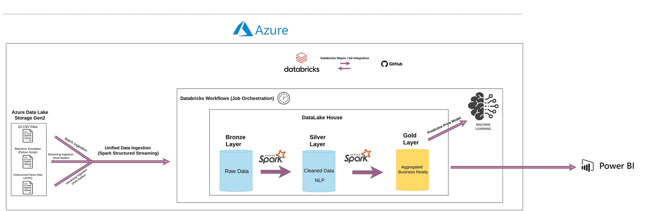





SYSTEM DESIGN
Project Architecture
Batch and streaming ingestion from multiple crypto sources
Bronze / Silver / Gold Medallion Architecture
Databricks Workflows orchestration
ML model for next-day price prediction
Power BI dashboard for business insights
UNIFIED CRYPTO INTELLIGENCE LAKEHOUSE
3
Notes:
TIMING: ~1.5 minutes. Walk the diagram left to right: 1) Sources on the left — market data APIs, social/news streams, blockchain metrics. 2) Ingestion layer — batch jobs and Structured Streaming pull data in continuously. 3) Bronze — raw data landed as-is for full traceability. 4) Silver — cleaned, validated, conformed schemas; batch and streaming joined here. 5) Gold — business-level aggregates: daily coin metrics, sentiment signals, flow signals. 6) From Gold: the ML pipeline trains/serves next-day price predictions, and Power BI reads Gold directly for dashboards. 7) Databricks Workflows orchestrates every stage end-to-end on a schedule.

Slide 4



ZOOM IN
Data Sources & NLP Pipeline
Supplementary view — how raw sources flow through the Medallion layers into analytics
Market Data
Social & News
Blockchain Metrics
Prices, volume, market cap — streaming API
Tweets, Reddit, headlines — raw text
On-chain transactions & exchange flow
BRONZE — Raw Batch + Structured Streaming Ingestion
SILVER — CLEANED & ENRICHED DATA
Cleaning & Transformation
NLP Sentiment Engine (on social text)
GOLD — Aggregated, Business-Ready Metrics
ANALYTICS, MARKET SIGNALS & ML PRICE FORECASTING
UNIFIED CRYPTO INTELLIGENCE LAKEHOUSE
4
Notes:
Optional slide — a zoomed-in view of source-to-NLP flow, matching the Medallion layers in the main architecture slide. Remove if it feels redundant.

Slide 5



TECH STACK
Technology Stack
Azure Data Lake
Gen2
Databricks
PySpark
Structured
Streaming
Scalable cloud storage
Unified analytics platform
Distributed data processing
Real-time ingestion
Delta Lake
MLflow /
Scikit-learn
Power BI
GitHub
ACID Lakehouse tables
ML tracking & modeling
Business intelligence
Version control & CI
UNIFIED CRYPTO INTELLIGENCE LAKEHOUSE
5

Slide 6

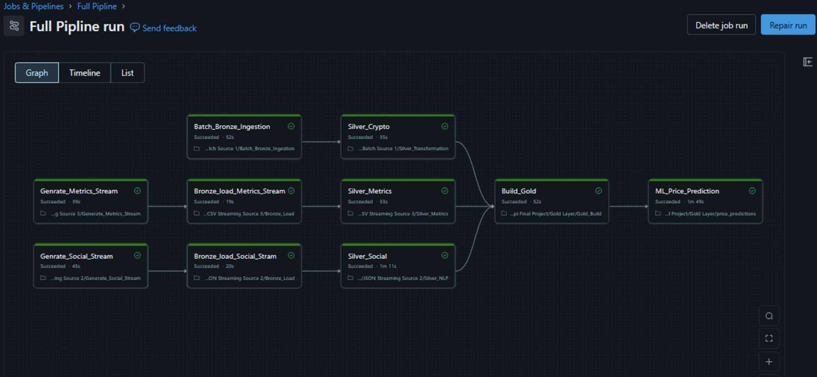
ORCHESTRATION
Pipeline Workflow
JOB SEQUENCE
1. Generate social stream
2. Generate metrics stream
3. Bronze ingestion
4. Silver transformations
5. Gold aggregations
6. ML prediction pipeline
Orchestrated end-to-end as Databricks Workflows jobs, with checkpointed streaming sources feeding the Medallion layers in sequence.
UNIFIED CRYPTO INTELLIGENCE LAKEHOUSE
6

Slide 7
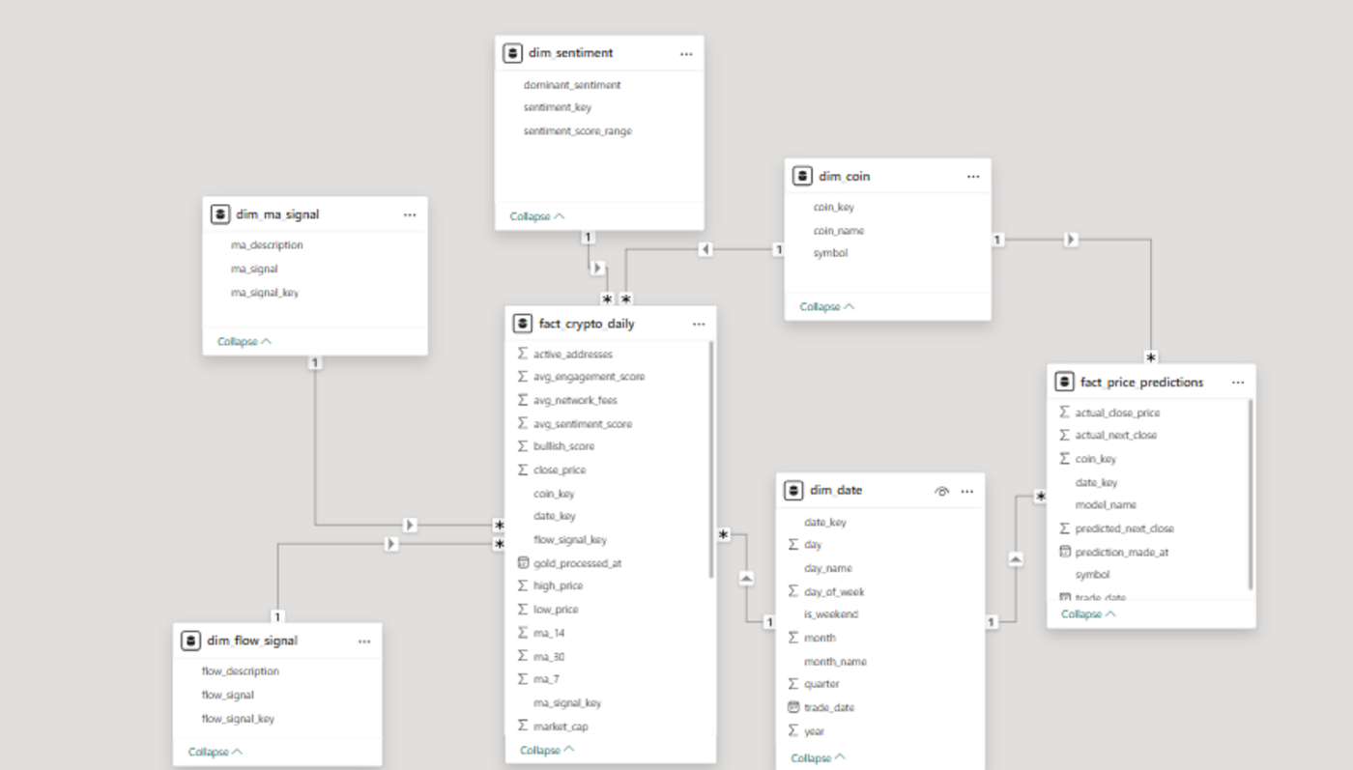

DATA MODELING
Galaxy Schema
FACT TABLES
fact_crypto_daily
fact_price_predictions
DIMENSIONS
dim_coin
dim_date
WHY GALAXY, NOT STAR?
dim_sentiment
dim_flow_signal
Two fact tables — daily metrics and price predictions — share conformed dimensions (coin, date, sentiment). A galaxy schema lets both analytics and ML forecasts query the same dimensions without duplicating them.
dim_ma_signal
UNIFIED CRYPTO INTELLIGENCE LAKEHOUSE
7

Slide 8
FORECASTING
Machine Learning
FEATURES USED
MODEL PERFORMANCE
Close Price
96.1%
ACCURACY
Market Cap
Trading Volume
3.9%
MAPE
MA7
MA14
MA30
$31.12
MAE (USD)
Sentiment Score
UNIFIED CRYPTO INTELLIGENCE LAKEHOUSE
8

Slide 9
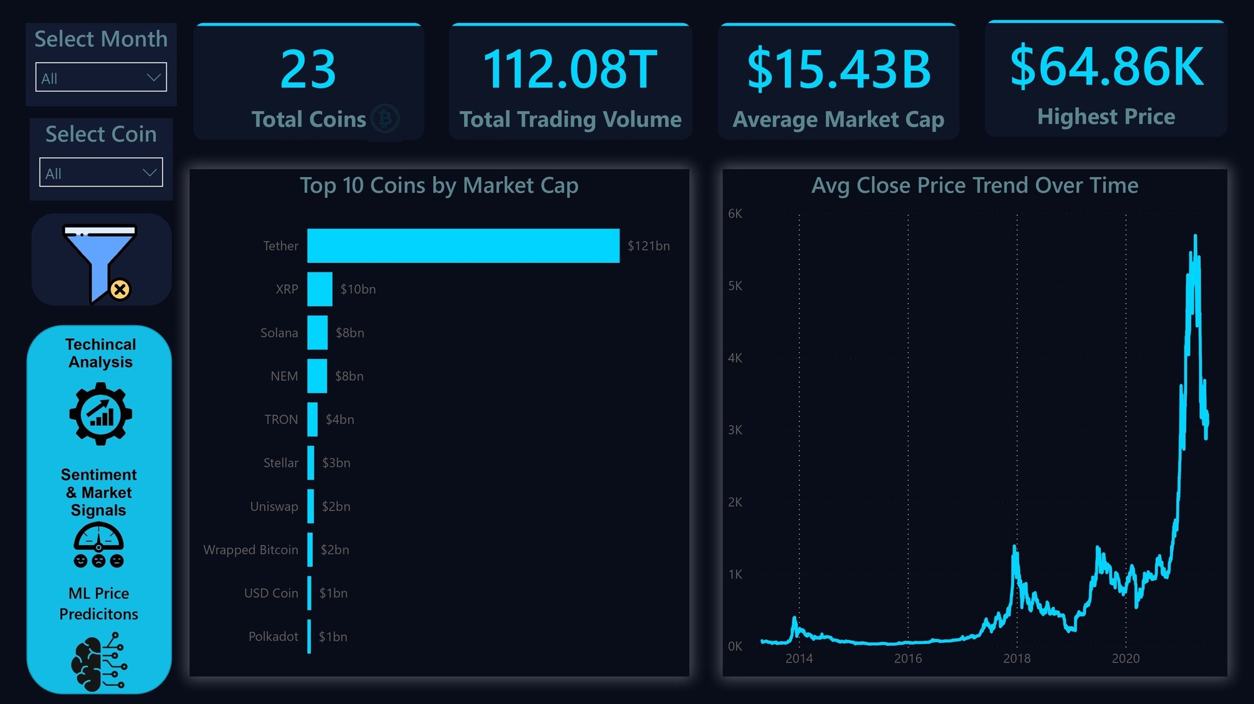
DASHBOARD DEMO
Market Overview
Market size across tracked coins
Top coins by cap & volume
Market cap distribution
UNIFIED CRYPTO INTELLIGENCE LAKEHOUSE
9

Slide 10
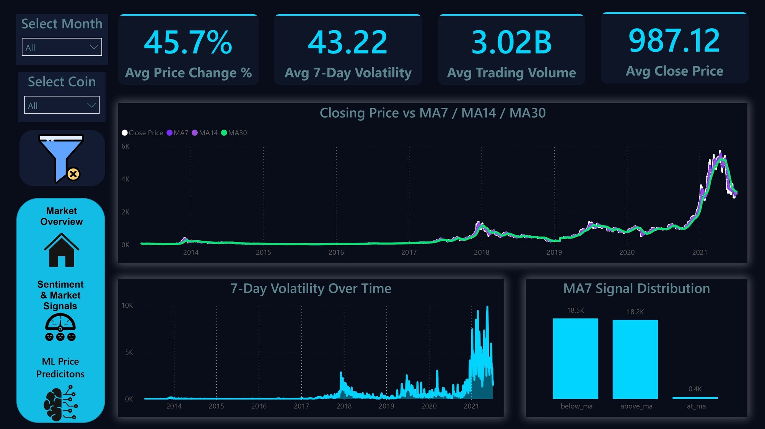
DASHBOARD DEMO
Technical Analysis
Moving averages (MA7 / MA14 / MA30)
Volatility tracking
MA-based trading signals
UNIFIED CRYPTO INTELLIGENCE LAKEHOUSE
10

Slide 11
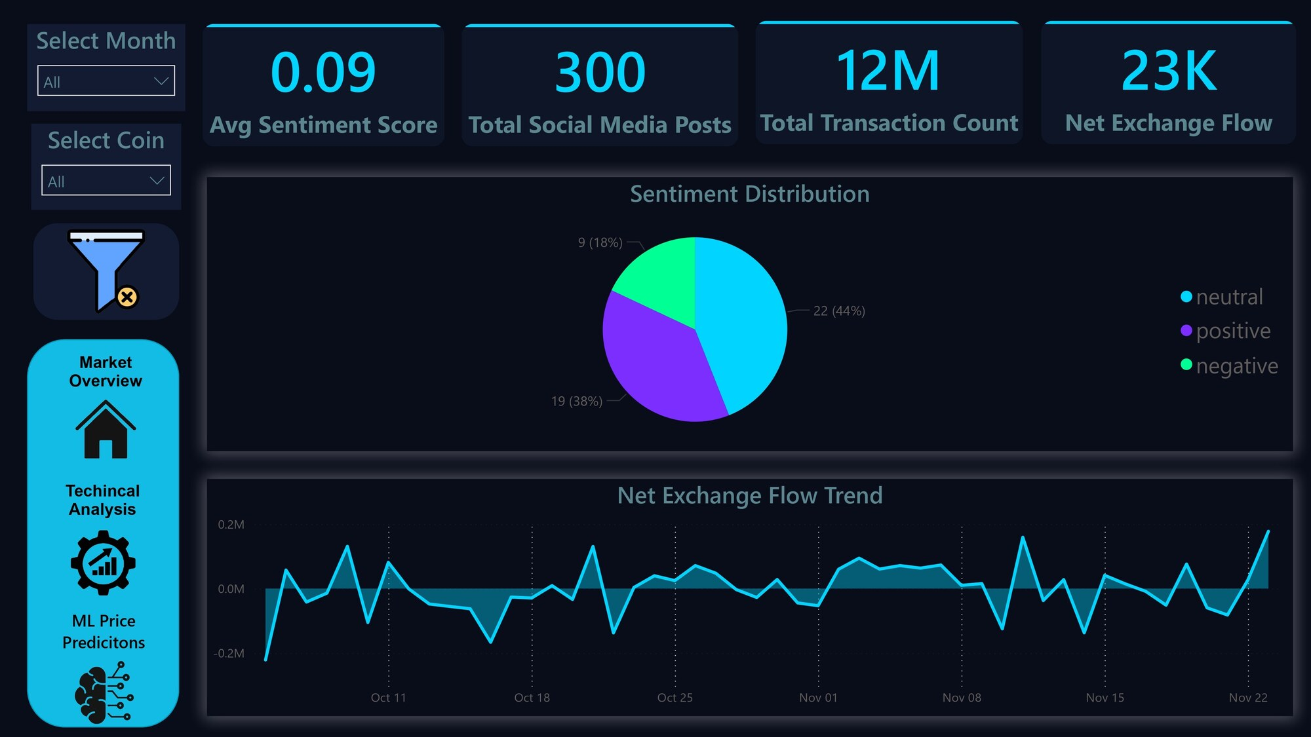
DASHBOARD DEMO
Sentiment & Market Signals
Social sentiment score over time
Exchange in/out flow
On-chain transaction metrics
UNIFIED CRYPTO INTELLIGENCE LAKEHOUSE
11

Slide 12
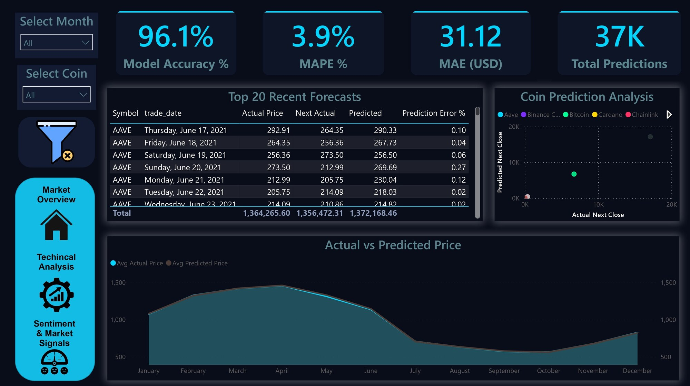
DASHBOARD DEMO
ML Predictions
Actual vs predicted price
Prediction error tracking
Next-period forecast table
UNIFIED CRYPTO INTELLIGENCE LAKEHOUSE
12

Slide 13

LESSONS
Challenges
Streaming Schema Evolution
Managing Checkpoints
Joining Batch & Streaming
Feature Engineering
Handling changing source schemas without breaking live streams
Ensuring exactly-once, resumable streaming state
Reconciling data of different latencies into Silver
Designing signals that meaningfully improve prediction
UNIFIED CRYPTO INTELLIGENCE LAKEHOUSE
13

Slide 14

OUTCOME
Results & Impact
Unified Analytics Platform
Real-Time Market Insights
One Lakehouse replacing fragmented, source-by-source analysis
Streaming ingestion keeps signals current to the minute
Automated ML Forecasting
End-to-End Scalable Pipeline
Next-day price prediction at 96.1% accuracy, no manual modeling
Orchestrated, checkpointed, and ready to add new sources
UNIFIED CRYPTO INTELLIGENCE LAKEHOUSE
14

Slide 15
Thank You
Questions & Discussion
Youssef Hamed Abdelmonim (Team Leader) · Seif Mohamed Fathi · Nada Mahmoud Hamed · Yehia Yasser Yehia · Nourhan Ahmed Gaber
UNIFIED CRYPTO INTELLIGENCE LAKEHOUSE
15

